Slide 1
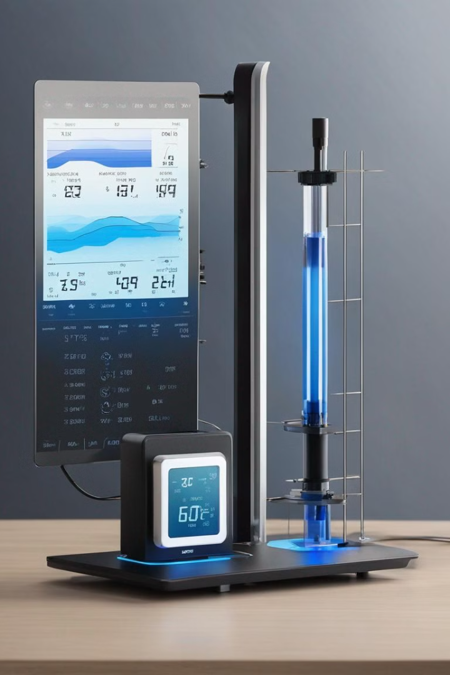
Arduino-Based Weather Station Project
Our project focuses on developing an Arduino-based weather station for educational and small-scale applications. It involves the integration of electronic sensors to measure and record weather data, along with the development of a user-friendly interface for data visualization and analysis.
The project is a collaborative effort from Aman Shaikh and Renesh Sharma, students at Pimpri Chinchwad University.

Slide 2

Introduction
1
Project Objective
We aim to create an affordable and reliable weather monitoring solution using Arduino technology. This project also serves as an educational experience, allowing us to delve into electronics, programming, and data analysis.

Slide 3

Project Objectives
1
Design and Build
2
Data Processing
Our primary goal is to design and build a weather station using Arduino and a selection of sensors to accurately measure and record weather data, including temperature, humidity, pressure, and rainfall.
We intend to process and display the collected weather data in a user-friendly format, enabling straightforward analysis and interpretation.

Slide 4
Project Scope
Sensor Selection
Hardware and Software Development
Data Processing and Calibration
User Interface
We plan to use sensors like the DHT22, BMP280, rain sensor, and LCD, collaborating with the Electronics department for guidance if needed.
Creating a user-friendly interface for real-time data visualization will be a key focus of the project.
We are considering implementing data processing algorithms and calibration methods, potentially in collaboration with the Physics department and AI to predict weather (possibly)
We will develop the Arduino hardware platform using a breadboard and jumper wires, along with coding the Arduino to acquire and process data, displaying it on the Display.

Slide 5
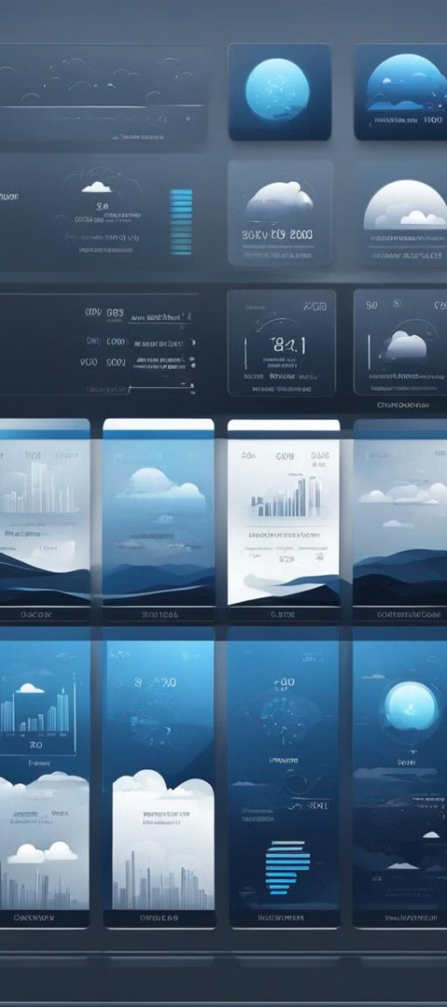
Components and Budget
1
Main Components
2
Total Estimated Cost
The primary components involve the Arduino, sensors (DHT22, BMP280, rain sensor), display, breadboard, and jumper wires.
The total estimated cost of the project is around 5000/- INR.

Slide 6




Visual Presentation of Data
Interactive Data Display
The collected data will be displayed on the OLED display connected to the Arduino
Real-Time via App/Web-page
Further improvements and revisions will include an interactive app/web-page to view data.
Introduction of AI
Possible introduction of AI to make predictions for weather forecasts based on existing collected data.

Slide 7
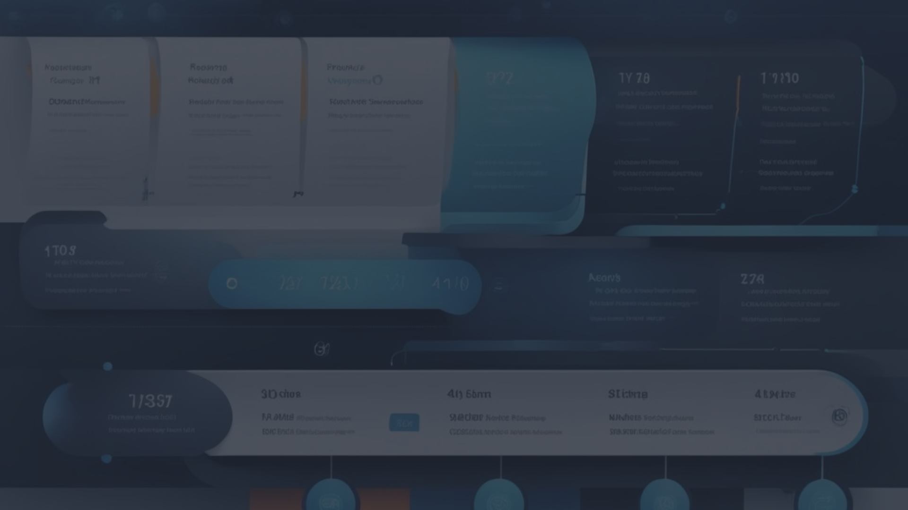
Project Timeline
Research and Procurement
1
Spending sufficient time on research and component procurement is crucial for the project's success.
2
Development and Integration
Hardware and software development phases will be executed simultaneously, aiming for seamless integration.
Testing and Finalization
3
Thorough user interface design and comprehensive testing will ensure a high-quality, reliable weather station.

Slide 8

Project Conclusion
1
Alignment with Curriculum
2
Skills Enhancement
The completion of this project aligns with our academic curriculum, providing the opportunity to apply theoretical knowledge into a practical, real-world application.
We are eager to enhance our skills in electronics, programming, and data analysis through this meaningful endeavor.
3
Collaboration Opportunity
The project encourages collaboration with professors from electronics, physics, and electrical engineering departments, allowing us to benefit from their expertise and guidance.

Slide 9

Q & A Session
Got questions? We've got answers! Ask away and let us provide you with the information you need.

